Slide 1


Difference from the previous works
The algorithm proposed in this paper is different from previous works in a number of different ways
Previous works had a variety of issues, from inefficiency to memory issues

Slide 2
Comparison with Topological Sorting Using Semi-External DFS (SETS)
The algorithm proposed in the paper is slower than Topological Sorting Using Semi-External DFS (SETS) in width-first algorithms
However, as graph size increases, or goes beyond memory size, the SETS algorithm starts failing
The proposed algorithm can run on any graph size, even those that are beyond memory size

Slide 3

Comparison with “ReachTS” and “PeelTS”
Both these algorithms were outperformed by IterTS in all kinds of graphs (Random, Layered, etc.)
These algorithms were often outperformed by a factor of 10
On large graphs, these algorithms were not even able to complete the computation in the given time

Slide 4
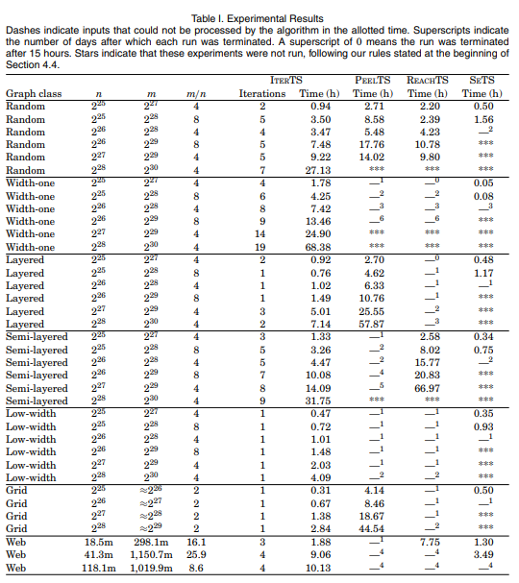

Slide 5
Details of the methodology adopted to solve the identified problem
Gist of the algorithm:- If an edge of a Directed Acyclic Graph’s (DAG) has a tail with a lower number than its head, then that edge is considered as “satisfied”
Whole graph is set with certain numbering, then loop is run, until the whole of the graph is satisfied, which improves the initialized numbering
To compute above numbering, an OutTree, and then an EulerTour is calculated

Slide 6
Preorder Numbering done on EulerTour, which returns two preorder numberings, one for the EulerTour, and another for the Reverse EulerTour
Initial Numbering is performed, which checks number of satisfied edges in EulerTour and Reverse EulerTour.
The ImproveNumbering Algorithm is then run, which takes the whole graph and returns a specific spanning tree that has the worst number of violations
Finally, a SatisfyTreeEdges algorithm is run, and the results are sorted, while number of satisfied edges are counted

